Slide 1
Predict and analyze patient outcome from medical record

Slide 2
Looking at data
1

Slide 3
Data
5 datasets with 5 trialss (studyA-E)
Variable:
1. Study - A character indicating which of the five studies the data represents.
2. Country - The country where the assessment was conducted.
3. PatientID - An identification number given to each unique patient.
4. SiteID - An identification number given to each unique assessment site.
5. RaterID - An identification number given to each unique rater.
6. AssessmentiD - An idenfication number given to each unique assessment conducted.
7. TxGroup - A string corresponding to the patient’s (randomly) assigned treatment group.
8. VisitDay - An integer corresponding to the number of days that have passed since the baseline assessment.
9. P1-P7 - The scores corresponding to each of the 7 positive symptoms of the assessment.
10. N1-N7 - The scores corresponding to each of the 7 negative symptoms of the assessment.
11. G1-G16 - The scores corresponding to each of the 16 general psychopathology symptoms of the assessment.
12. PANSS_Total - The sum of of the ratings across the 30 PANSS items.
13. LeadStatus - A string indicating whether the assessment’s audit passed, was flagged, or was assigned to a CS (i.e. clinical specialist).

Slide 4
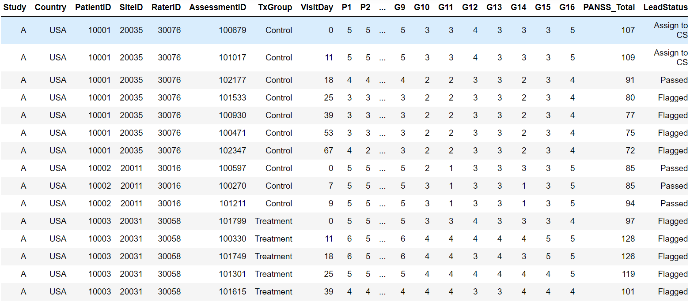
Data
5 datasets with 5 trialss (studyA-E)

Slide 5
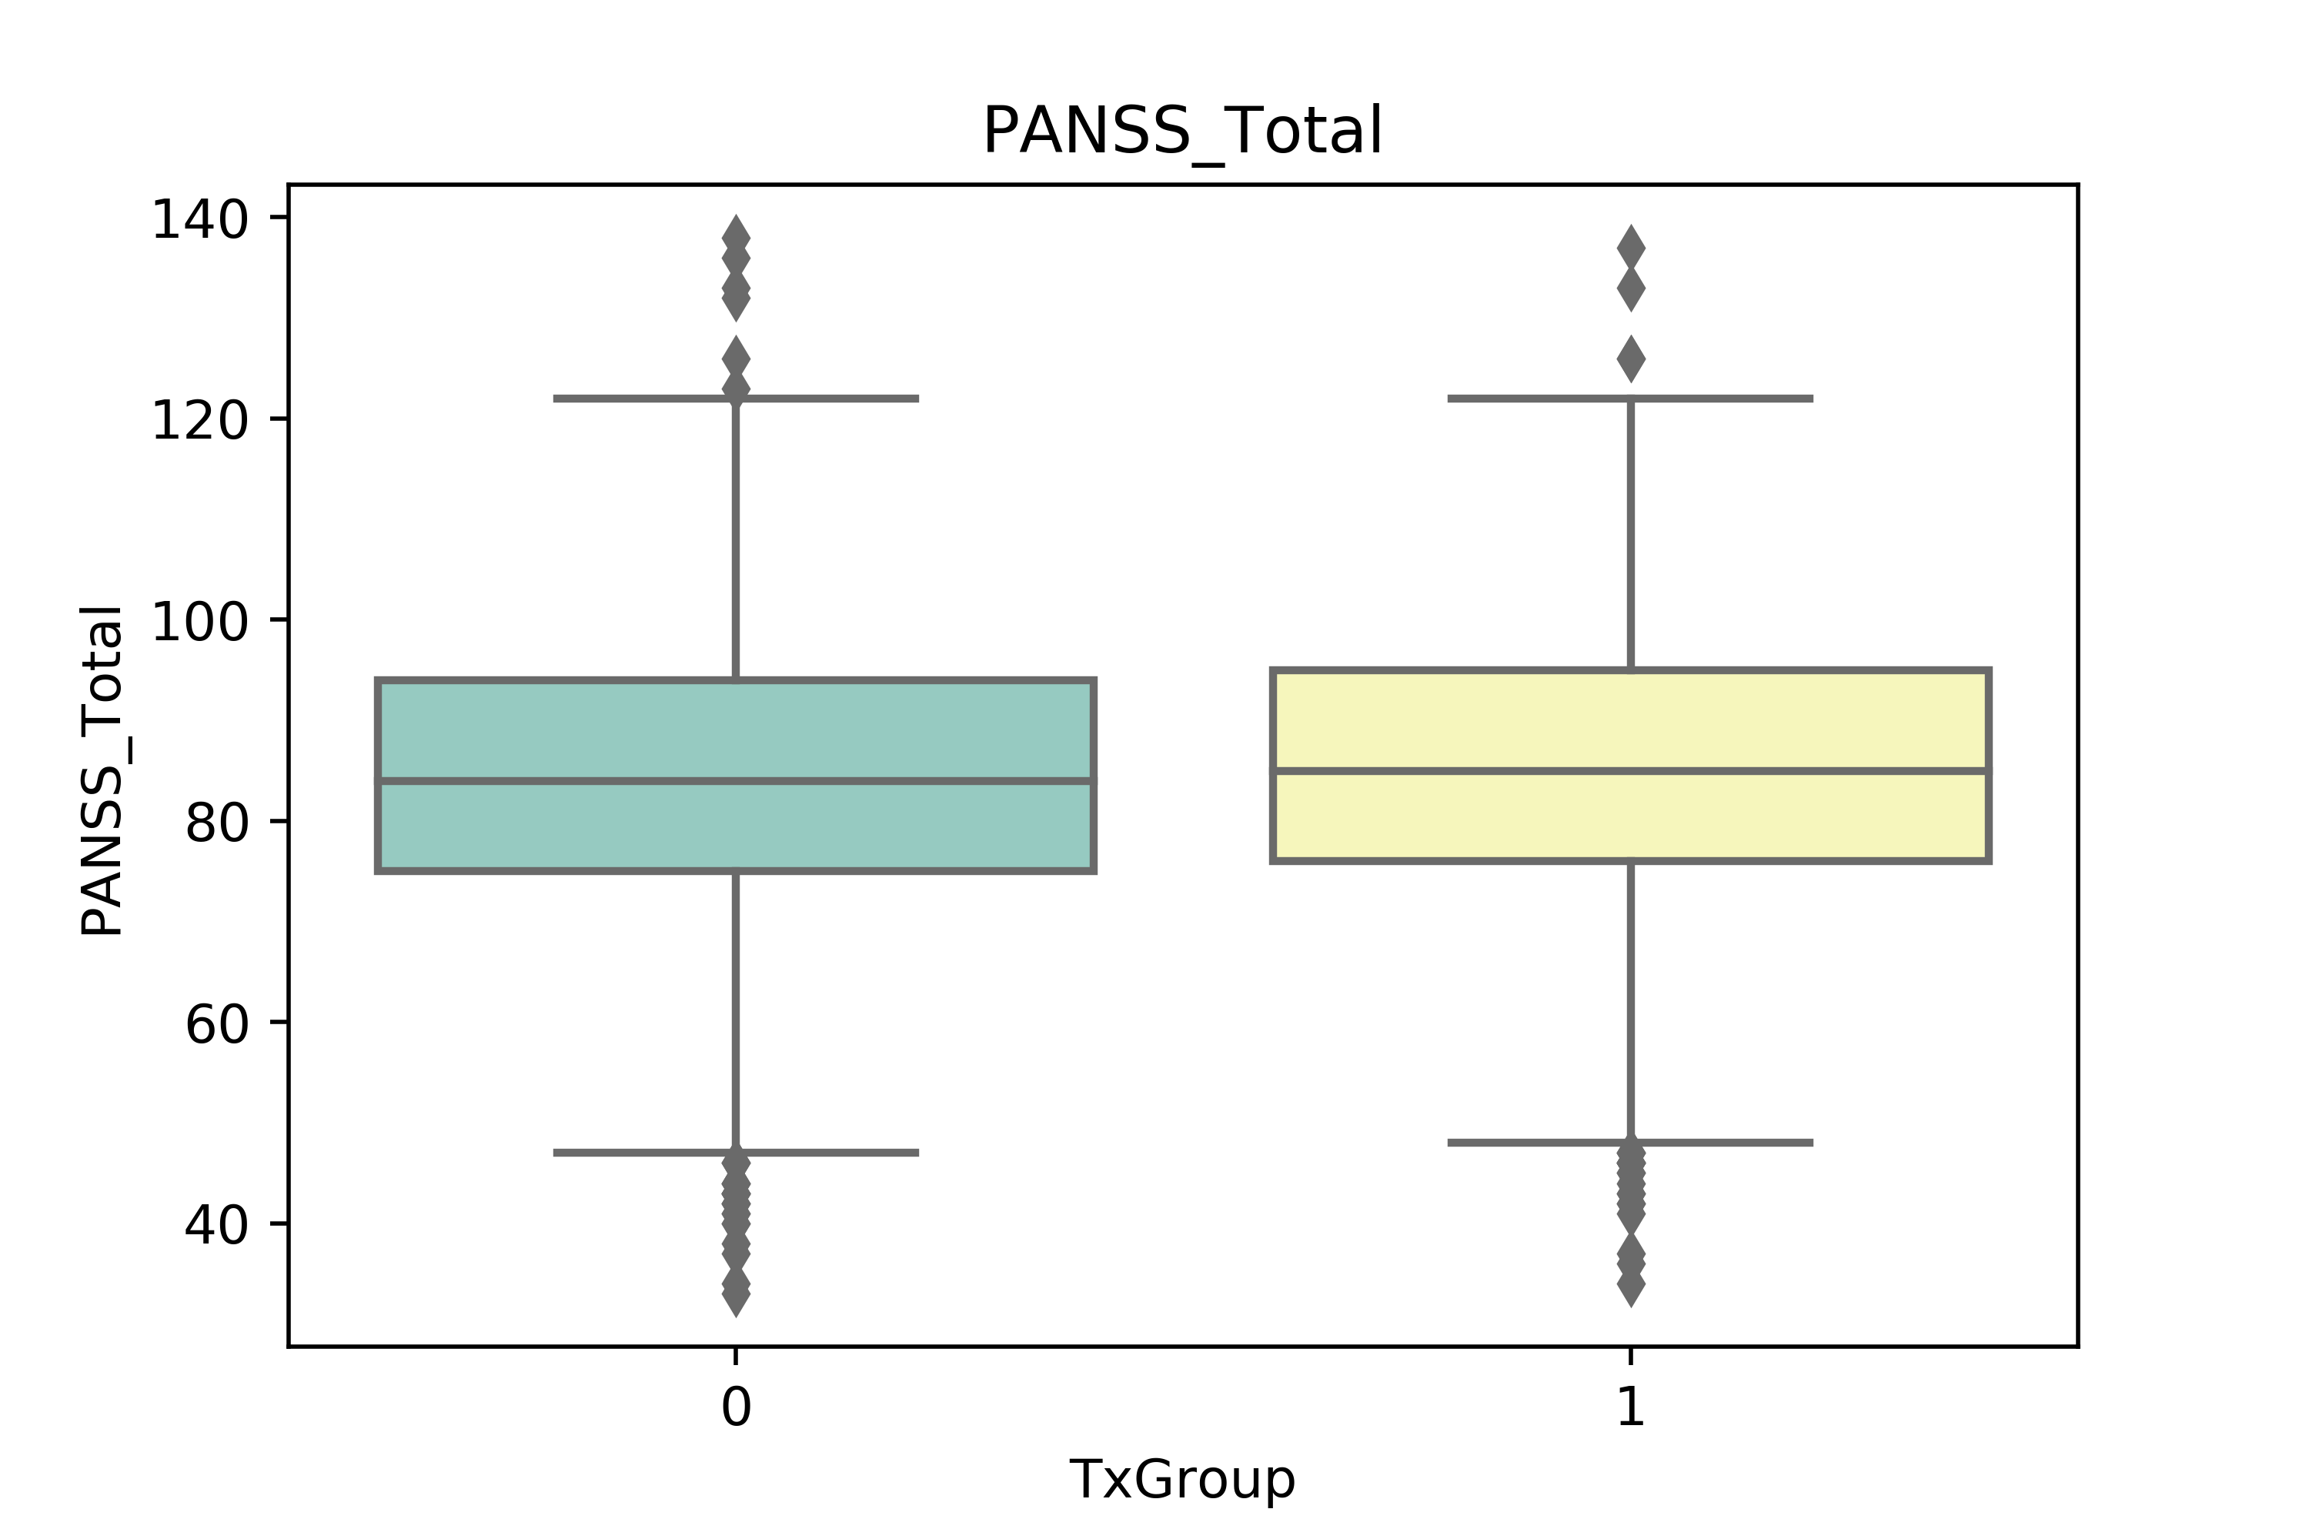
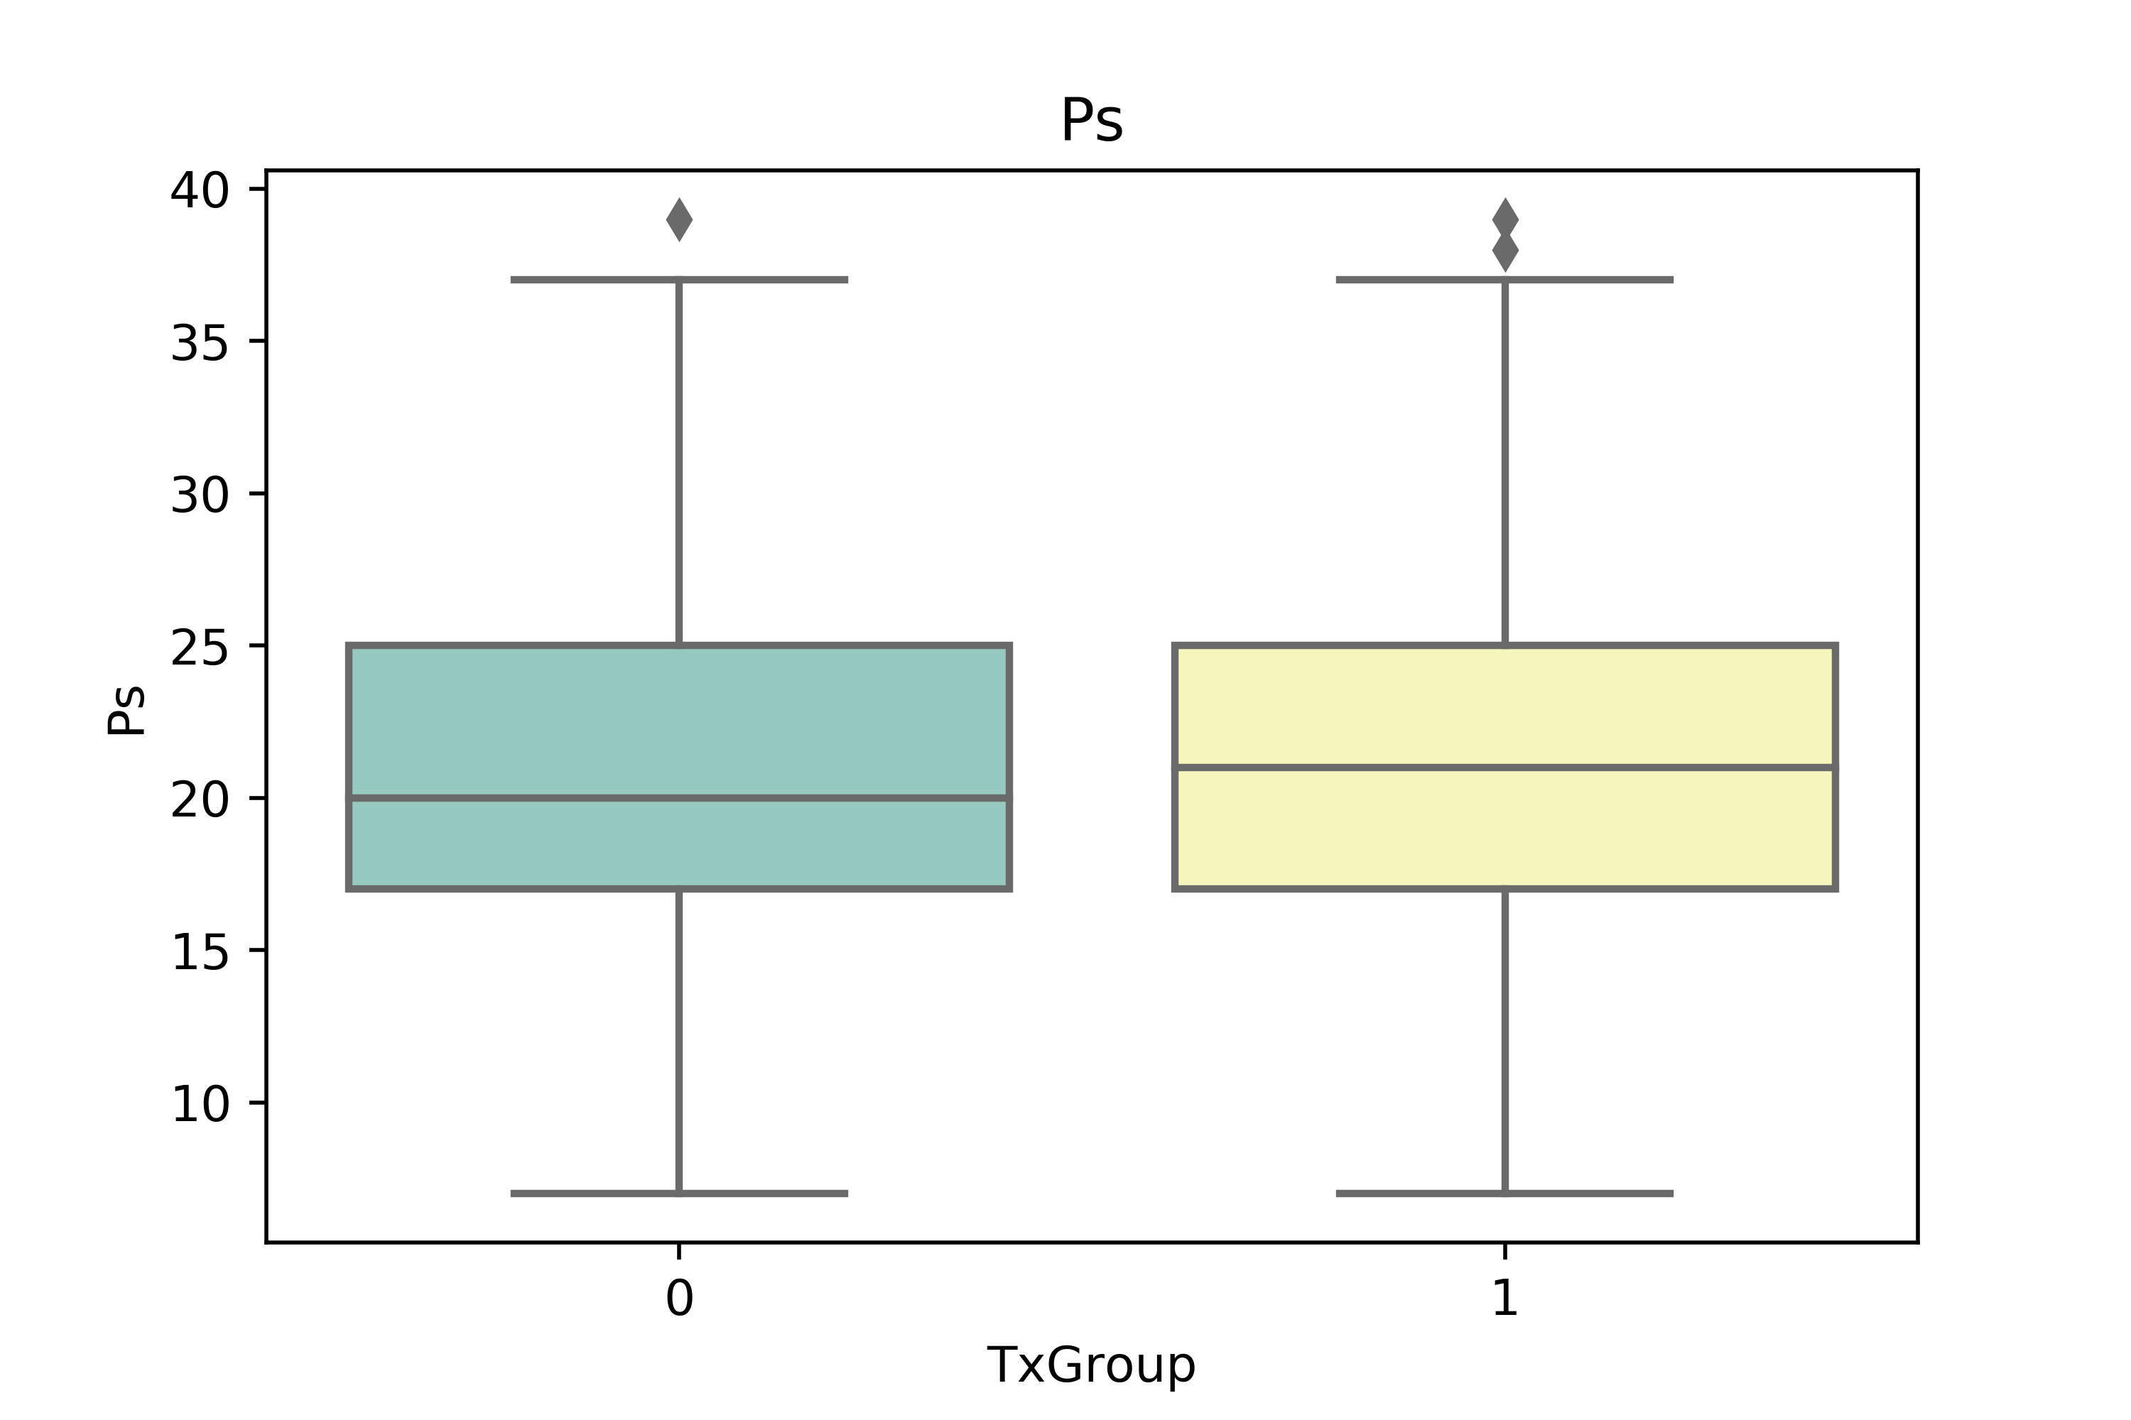
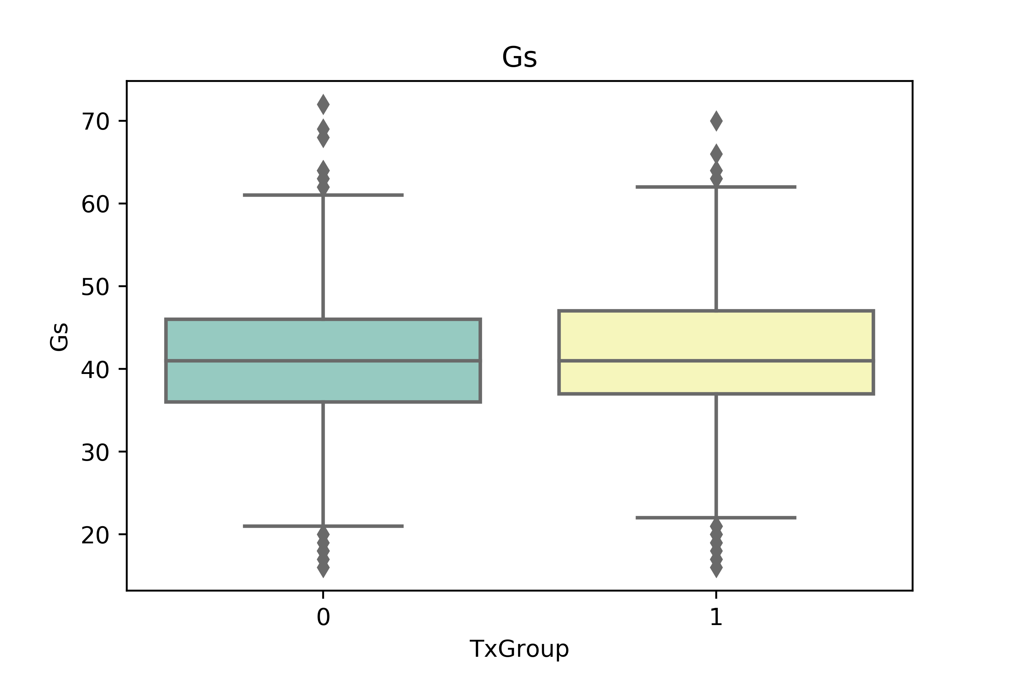

Stakeholder would like to know – Does the treatment has an effect on the disease?
Before the analysis : Ensure the treatment and control groups are substantially the same before the study begin – look at the summary statistic for the treatment and control groups
The median value is slightly different for Ps, Gs, Ns
→ the difference between the current score and the previous one for the same patient)

Slide 6
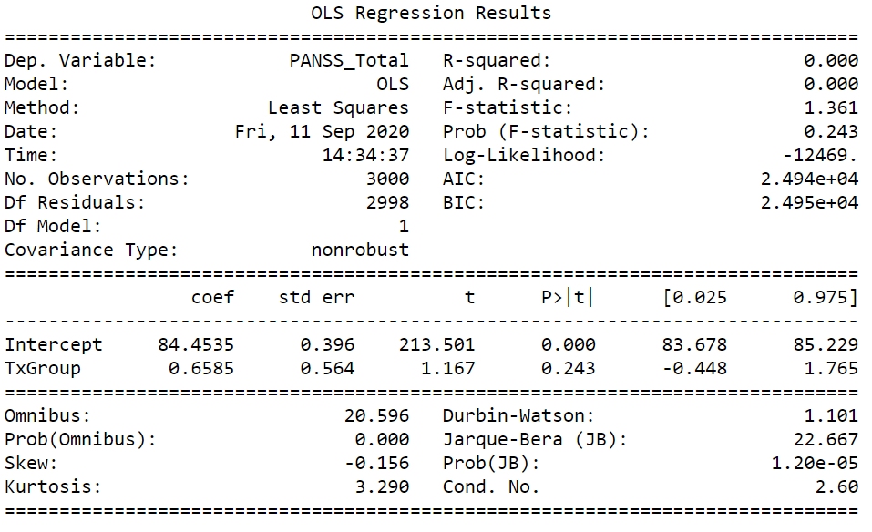
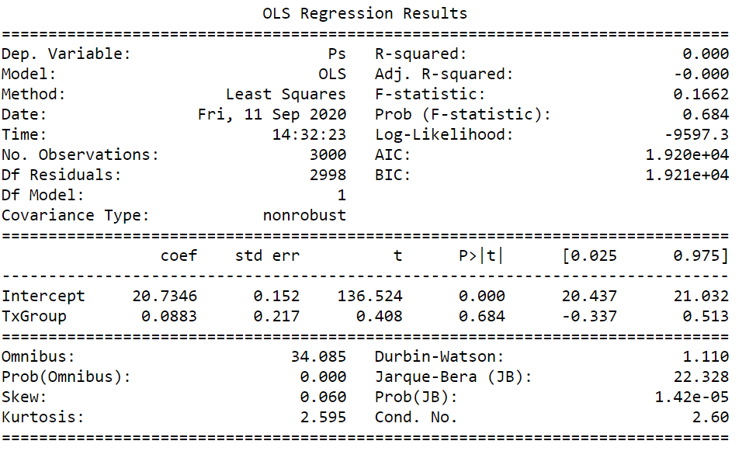
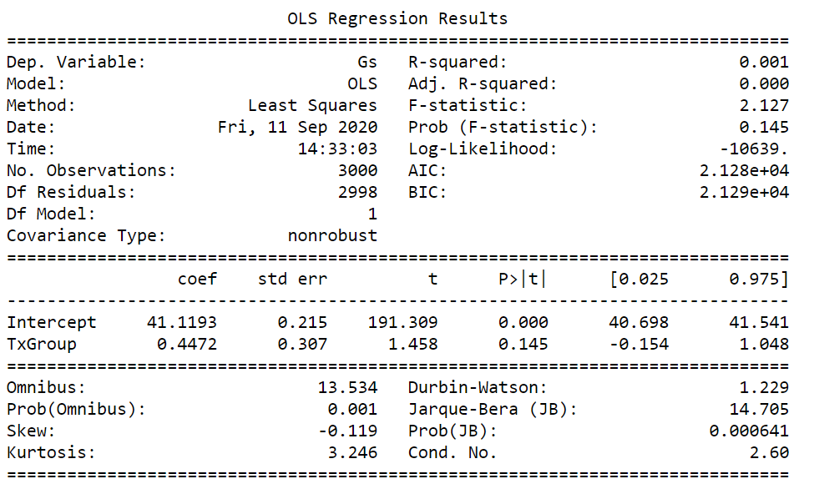
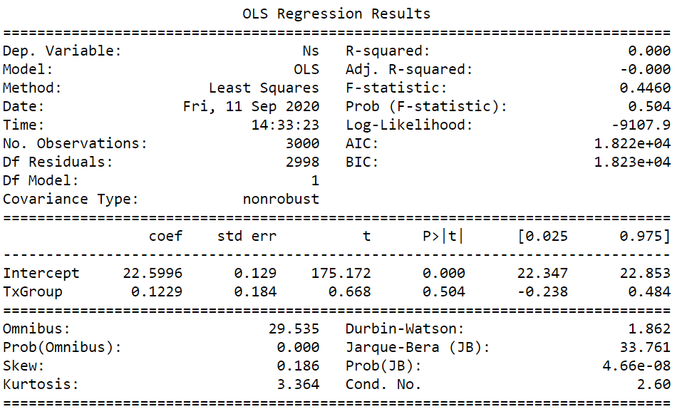
Stakeholder would like to know – Does the treatment has an effect on the disease?
Before the analysis :Ensure the treatment and control groups are substantially the same before the study begin – look at the summary statistic for the treatment and control groups
Null hypothesis test:
the difference between the control and treatment groups is not statistically significant

Slide 7
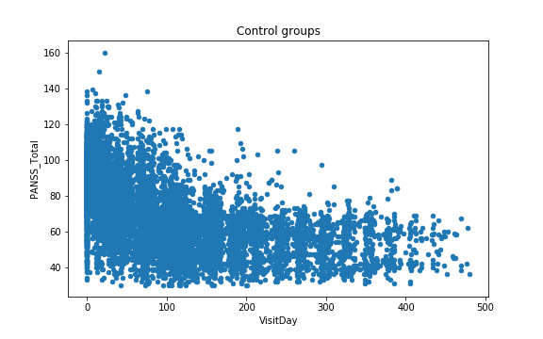
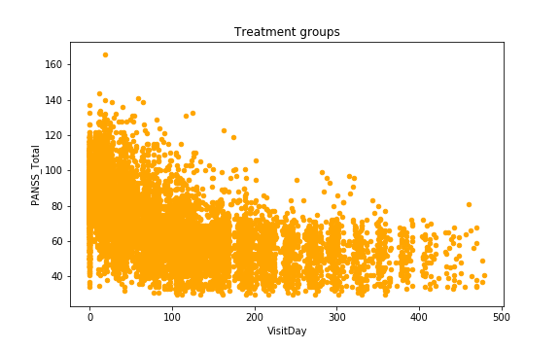
Stakeholder would like to know – Dose the treatment has an effect on the disease?
Data visualization: Control groups v.s treatment groups: The plot looks similar

Slide 8
Stakeholder would like to know – Dose the treatment has an effect on the disease?
Original analysis : Used PANSS_Total_diff (the difference between the current PANSS_total score and the previous one for the same patient) to form regression against Visitday and treatment
Because the PANSS_total score varied from patient to patient, this ensures that we are evaluating the effects of the treatment, on the changes in the PANSS core.
The linear regression is:
PANSS_Total_diff=β0+β1TxGroup+β2VisitDay +β3TxGroup*VisitDay +ϵ
TxGroup =1 (Treatment) PANSS_Total_diff =β0+β1+β2VisitDay +β3VisitDay +ϵ
= β0+β1 + (β2+ β3)VisitDay +ϵ
TxGroup =0 (Control) PANSS_Total_diff =β0+β2VisitDay +ϵ
Null-hypothesis: β3=0
If the p-value for TxGroup*VisitDay is < 0.05: statistical significance

Slide 9
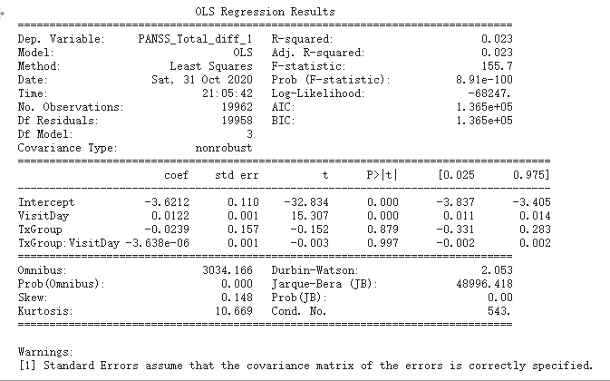
Stakeholder would like to know – Does the treatment has an effect on the disease?
p-value for TxGroup*VisitDay = 0.997:
not statistical significance

Slide 10
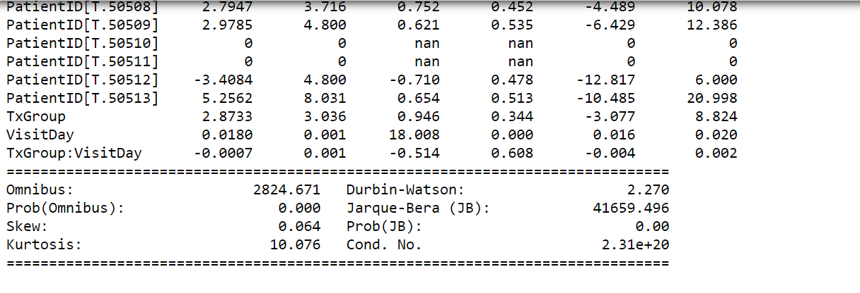
Stakeholder would like to know – Does the treatment has an effect on the disease?
Analysis1. analysis 1 + added categorical variables for different studies to the regression
In analysis 1, Different studies (trials) have different patient population. For example, the patient from study A is all from USA and the patient from study E is from China → Different studies may have bias result to the analysis
The linear regression become:
PANSS_Total_diff= β0+β1TxGroup+β2VisitDay +β3TxGroup*VisitDay + β4PatientID +ϵ
The p value for TxGroup variable is 0.351 → Fail to reject the null hypothesis

Slide 11
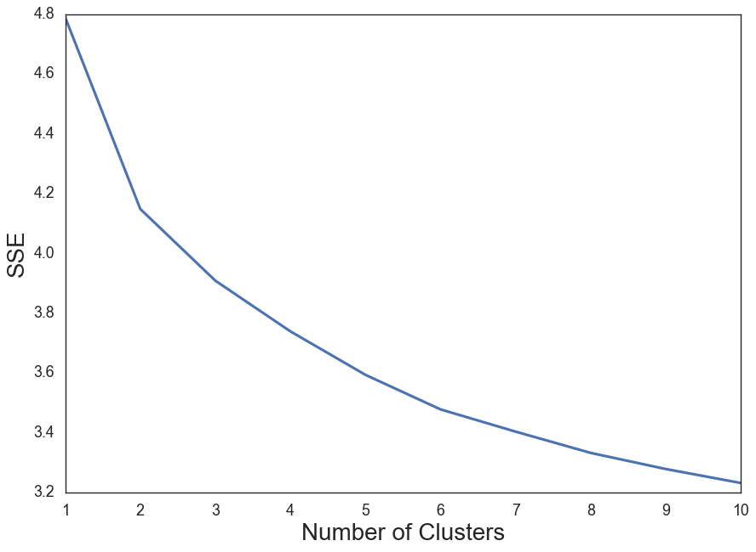
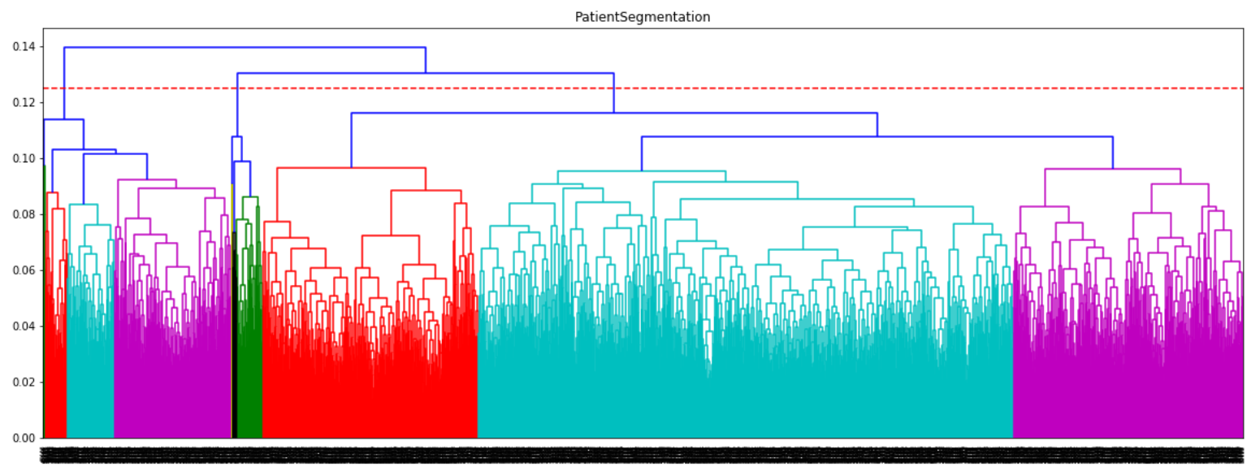
Patient segmentation – understand each groups oh patients for their mental health status
Data preprocess : data is first normalized (The distance measures are affected by the scale of the variables)
Data mining/evaluation: complete linkage clustering/ K-means clustering
- The red dotted line indicates the level at which the data is segmented. The dissimilarity between the three clusters created by seat the dotted line is greater than the ones that would have been created by cutting at a higher level (for two segments). Sub-segments below that are relatively similar with the other segments in their respective groups.
- Interpretable

Slide 12
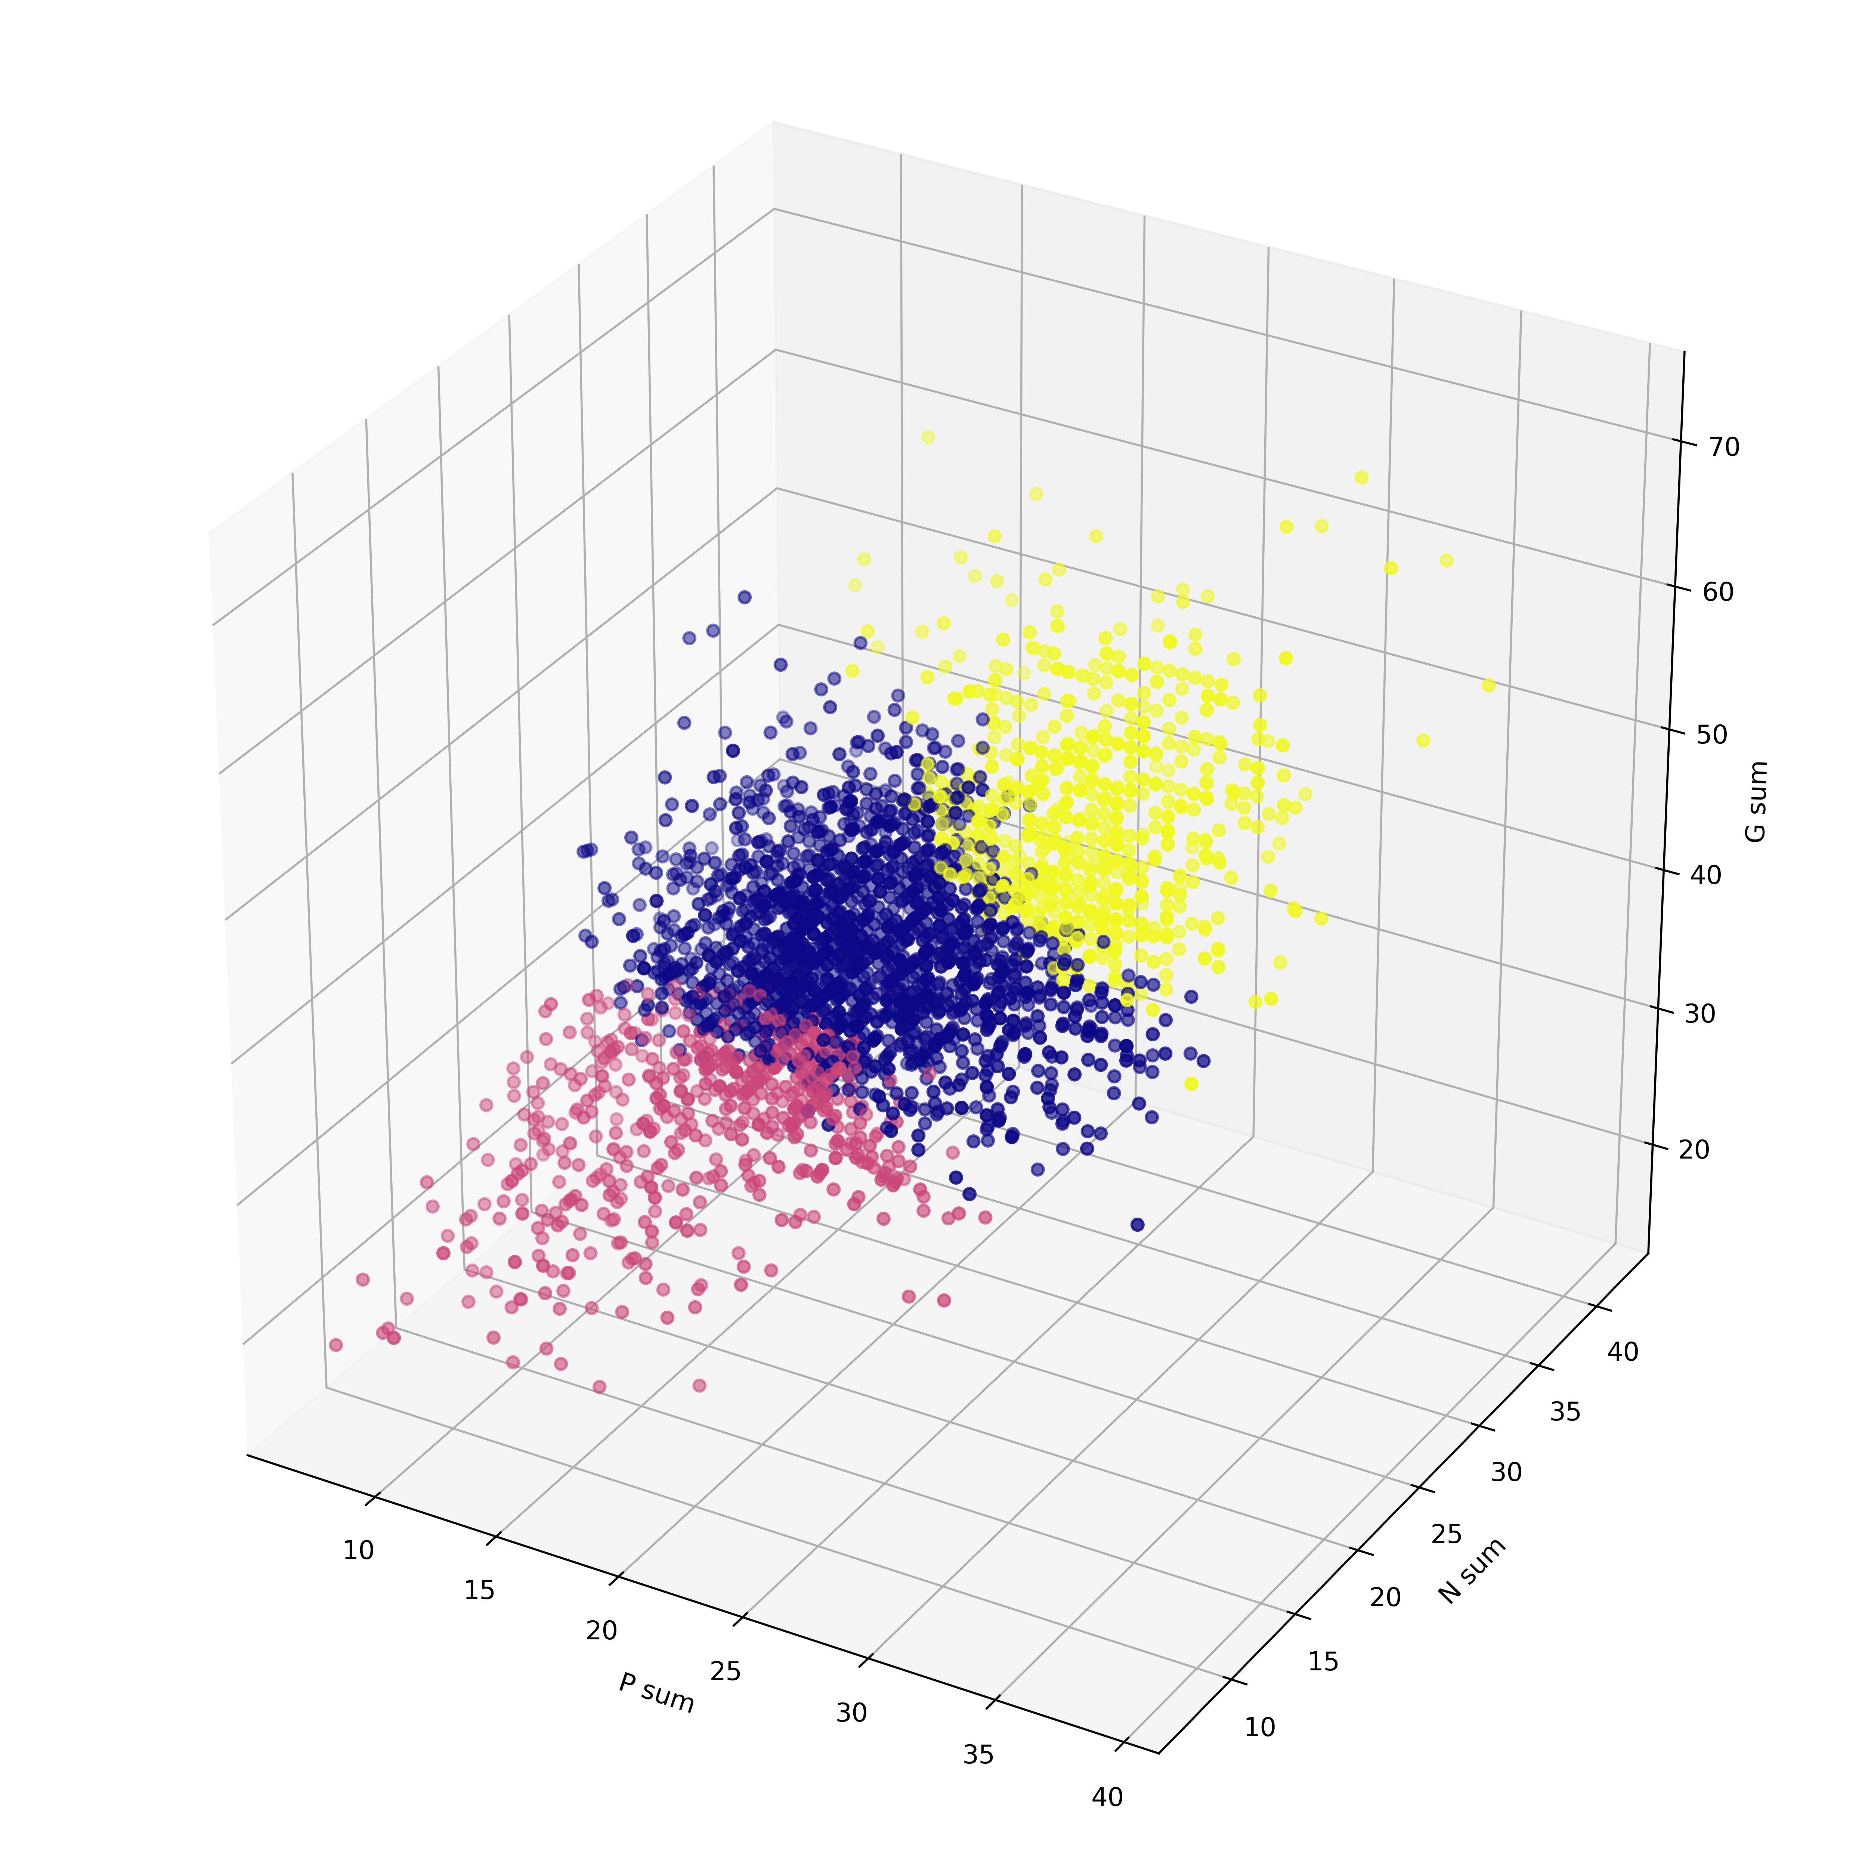
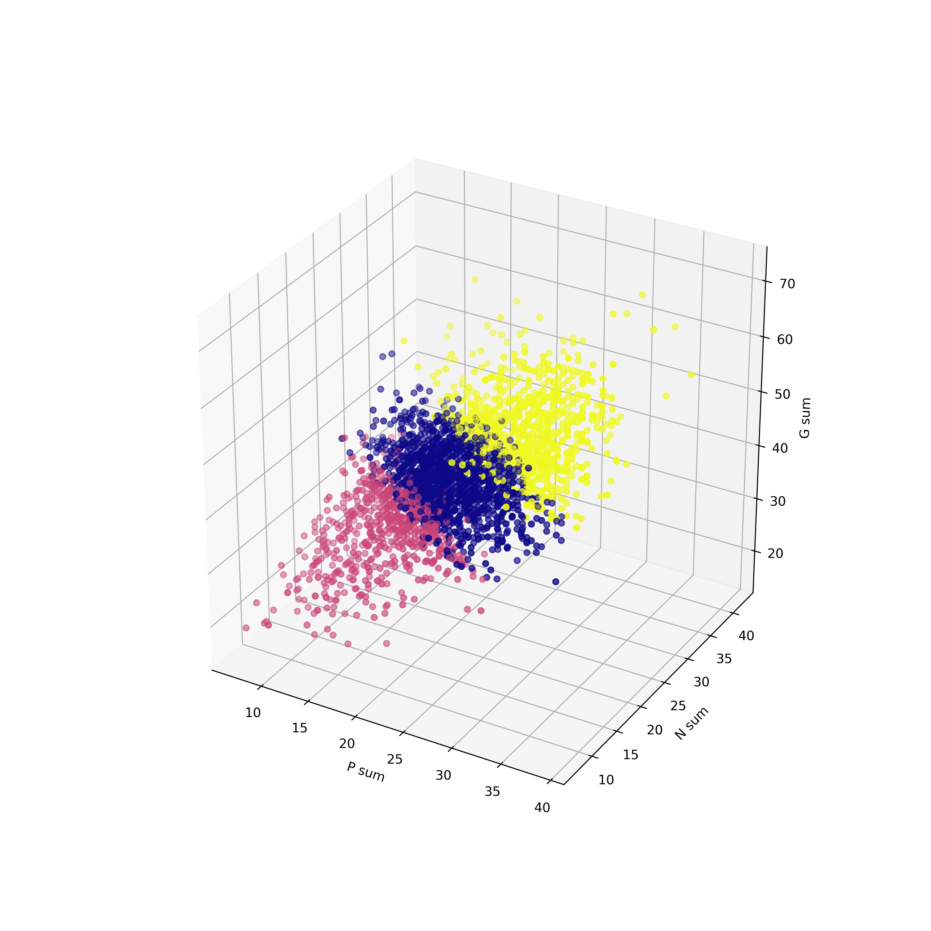
Patient segmentation – understand each groups oh patients for their mental health status
Data preprocess : data is first normalized (The distance measures are affected by the scale of the variables)
Data mining/evaluation: complete linkage clustering and K-means clustering (k=3)
complete linkage clustering
K-means clustering
K-means clustering shows better separation of the individual clusters from each other.

Slide 13
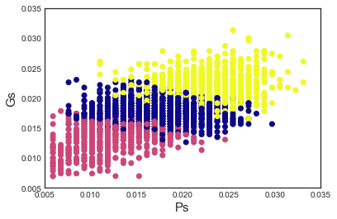
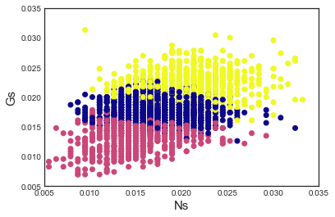
Patient segmentation – understand each groups oh patients for their mental health status
Data preprocess : data is first normalized (The distance measures are affected by the scale of the variables)
Data mining/evaluation: complete linkage clustering and K-means clustering (k=3)
K-means clustering
1. Each cluster indicates a different combination of the sub-group scores. Moving from he ‘Pink’ cluster to the ‘Blue’ cluster requires an increase in all three sub-group scores.
2. To move from ‘blue’ cluster to ‘yellow’ cluster only requires a relatively smaller increase in the ‘G’ subgroup sum, whereas relatively similar changes in ‘Ps’ sum or ‘Ns’ sum doesn’t result in crossing over to the next cluster.

Slide 14
Stakeholder would like to know – Dose the treatment has an effect on the disease?
EDIT IN POWERPOINT®
Click on the button under the presentation preview that says "Download as PowerPoint template". You will get a .pptx file that you can edit in PowerPoint.
Remember to download and install the fonts used in this presentation (you’ll find the links to the font files needed in the Presentation design slide)
EDIT IN POWERPOINT®
Click on the button under the presentation preview that says "Download as PowerPoint template". You will get a .pptx file that you can edit in PowerPoint.
Remember to download and install the fonts used in this presentation (you’ll find the links to the font files needed in the Presentation design slide)

Slide 15
Stakeholder would like to know – Dose the treatment has an effect on the disease?
Before the analysis :Ensure the treatment and control groups are substantially the same before the study begin – look at the summary statistic for the treatment and control groups
Analysis: Used PANSS_Total_diff (the difference between the current PANSS_total score and the previous one for the same patient – because the PNASS_total score varied from patient to patient, this ensures that we are evaluating the effects of the treatment, on the changes in the PANSS score.
EDIT IN POWERPOINT®
Click on the button under the presentation preview that says "Download as PowerPoint template". You will get a .pptx file that you can edit in PowerPoint.
Remember to download and install the fonts used in this presentation (you’ll find the links to the font files needed in the Presentation design slide)

Slide 16
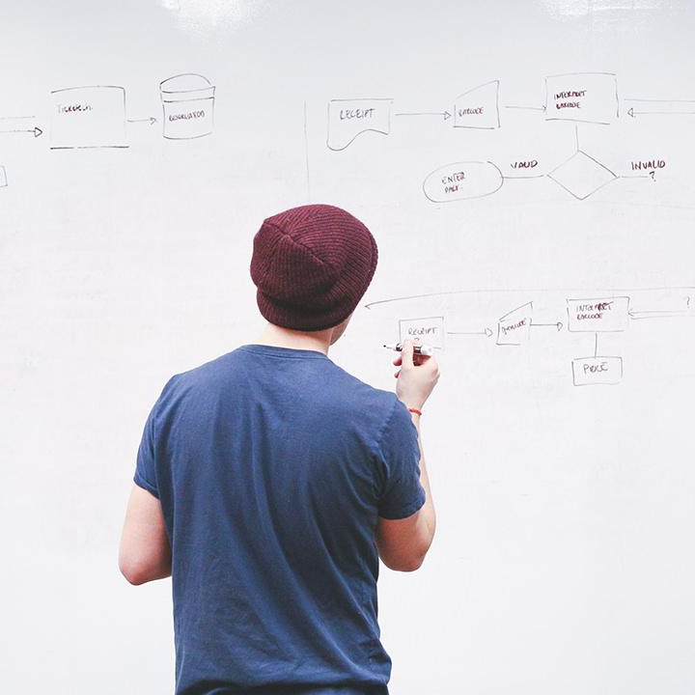
HELLO!
I am Jayden Smith
I am here because I love to give presentations.
You can find me at @username

Slide 17
Quotations are commonly printed as a means of inspiration and to invoke philosophical thoughts from the reader.

Slide 18
THIS IS A SLIDE TITLE
Here you have a list of items
And some text
But remember not to overload your slides with content
Your audience will listen to you or read the content, but won’t do both.

Slide 19
BIG CONCEPT
Bring the attention of your audience over a key concept using icons or illustrations

Slide 20
YOU CAN ALSO SPLIT YOUR CONTENT
White
Is the color of milk and fresh snow, the color produced by the combination of all the colors of the visible spectrum.
Black
Is the color of ebony and of outer space. It has been the symbolic color of elegance, solemnity and authority.

Slide 21
IN TWO OR THREE COLUMNS
Yellow
Is the color of gold, butter and ripe lemons. In the spectrum of visible light, yellow is found between green and orange.
Blue
Is the colour of the clear sky and the deep sea. It is located between violet and green on the optical spectrum.
Red
Is the color of blood, and because of this it has historically been associated with sacrifice, danger and courage.

Slide 22

A PICTURE IS WORTH A THOUSAND WORDS
A complex idea can be conveyed with just a single still image, namely making it possible to absorb large amounts of data quickly.

Slide 23

Want big impact?
USE BIG IMAGE

Slide 24
USE CHARTS TO EXPLAIN YOUR IDEAS
White
Gray
Black

Slide 25
AND TABLES TO COMPARE DATA
 | A | B | C
Yellow | 10 | 20 | 7
Blue | 30 | 15 | 10
Orange | 5 | 24 | 16

Slide 26
MAPS
OUR OFFICE

Slide 27
89,526,124
Whoa! That’s a big number, aren’t you proud?

Slide 28
89,526,124$
185,244 users
100%
That’s a lot of money
And a lot of users
Total success!

Slide 29
OUR PROCESS IS EASY
first
second
last

Slide 30
LET’S REVIEW SOME CONCEPTS
Yellow
Is the color of gold, butter and ripe lemons. In the spectrum of visible light, yellow is found between green and orange.
Blue
Is the colour of the clear sky and the deep sea. It is located between violet and green on the optical spectrum.
Red
Is the color of blood, and because of this it has historically been associated with sacrifice, danger and courage.
Yellow
Is the color of gold, butter and ripe lemons. In the spectrum of visible light, yellow is found between green and orange.
Blue
Is the colour of the clear sky and the deep sea. It is located between violet and green on the optical spectrum.
Red
Is the color of blood, and because of this it has historically been associated with sacrifice, danger and courage.

Slide 31
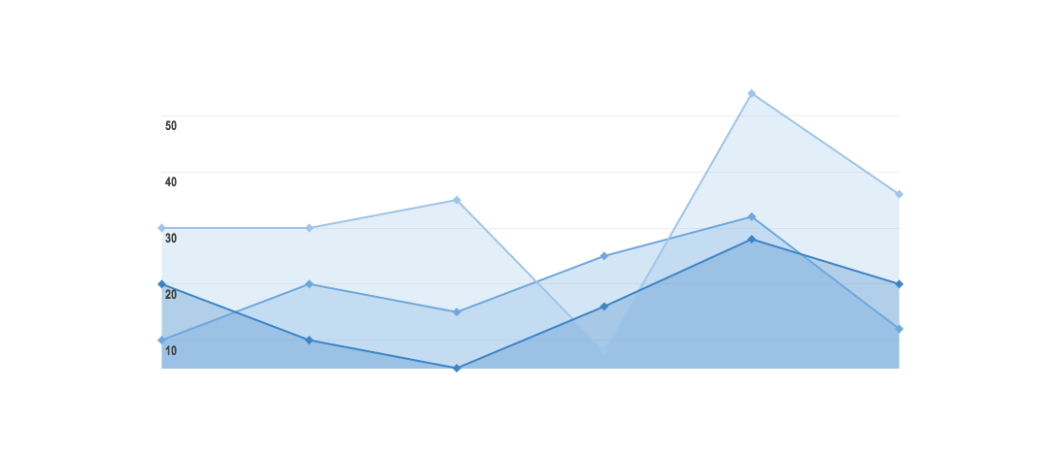
GRAPH TITLE
You can insert graphs from Google Sheets

Slide 32
Place your screenshot here
ANDROID PROJECT
Show and explain your web, app or software projects using these gadget templates.

Slide 33
iPHONE PROJECT
Show and explain your web, app or software projects using these gadget templates.
Place your screenshot here

Slide 34
Place your screenshot here
TABLET PROJECT
Show and explain your web, app or software projects using these gadget templates.

Slide 35
Place your screenshot here
DESKTOP PROJECT
Show and explain your web, app or software projects using these gadget templates.

Slide 36
THANKS!
Any questions?
You can find me at
@username & user@mail.me

Slide 37
CREDITS
Special thanks to all the people who made and released these awesome resources for free:
Presentation template by SlidesCarnival
Photographs by Startup Stock Photos

Slide 38
PRESENTATION DESIGN
This presentation uses the following typographies and colors:
Titles: Roboto Condensed
Body copy: Roboto Condensed
You can download the fonts on this page:
https://material.io/guidelines/resources/roboto-noto-fonts.html
Navy #3f5378 · Dark navy #263248 · Yellow #ff9800
You don’t need to keep this slide in your presentation. It’s only here to serve you as a design guide if you need to create new slides or download the fonts to edit the presentation in PowerPoint®

Slide 39
SlidesCarnival icons are editable shapes.
This means that you can:
Resize them without losing quality.
Change line color, width and style.
Isn’t that nice? :)
Examples:

Slide 40
Diagrams and infographics

Slide 41
😉
Now you can use any emoji as an icon!
And of course it resizes without losing quality and you can change the color.
How? Follow Google instructions https://twitter.com/googledocs/status/730087240156643328
✋👆👉👍👤👦👧👨👩👪💃🏃💑❤😂😉😋😒😭👶😸🐟🍒🍔💣📌📖🔨🎃🎈🎨🏈🏰🌏🔌🔑 and many more...

Slide 42

Free templates for all your presentation needs
For PowerPoint and Google Slides
100% free for personal or commercial use
Ready to use, professional and customizable
Blow your audience away with attractive visuals

